Slide 1
Differential Correlation
Tyler Stoen

Slide 2
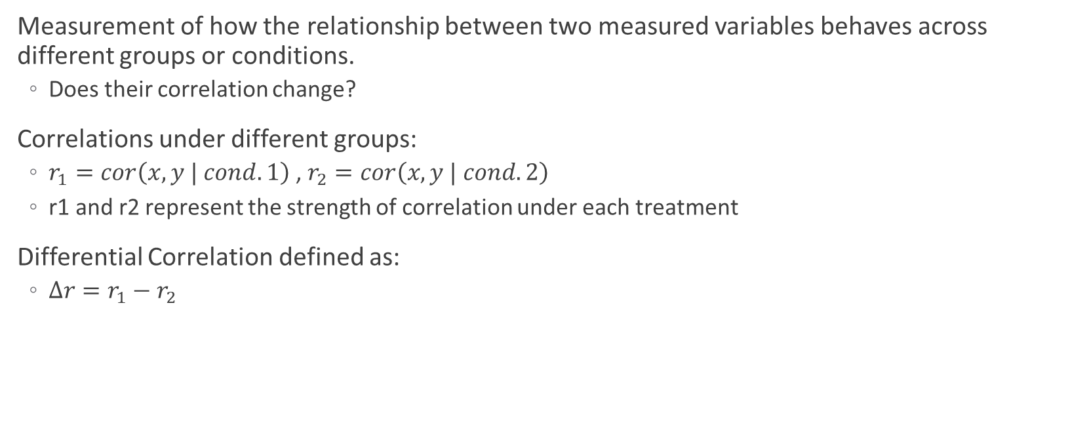
What is Differential Correlation?
Measurement of how the relationship between two measured variables behaves across different groups or conditions.
Does their correlation change?
Correlations under different groups:
$r_{1}=cor\left(x,y | cond. 1\right)$ , $r_{2}=cor\left(x,y | cond. 2\right)$
r1 and r2 represent the strength of correlation under each treatment
Differential Correlation defined as:
$Δr=r_{1}−r_{2}$

Slide 3
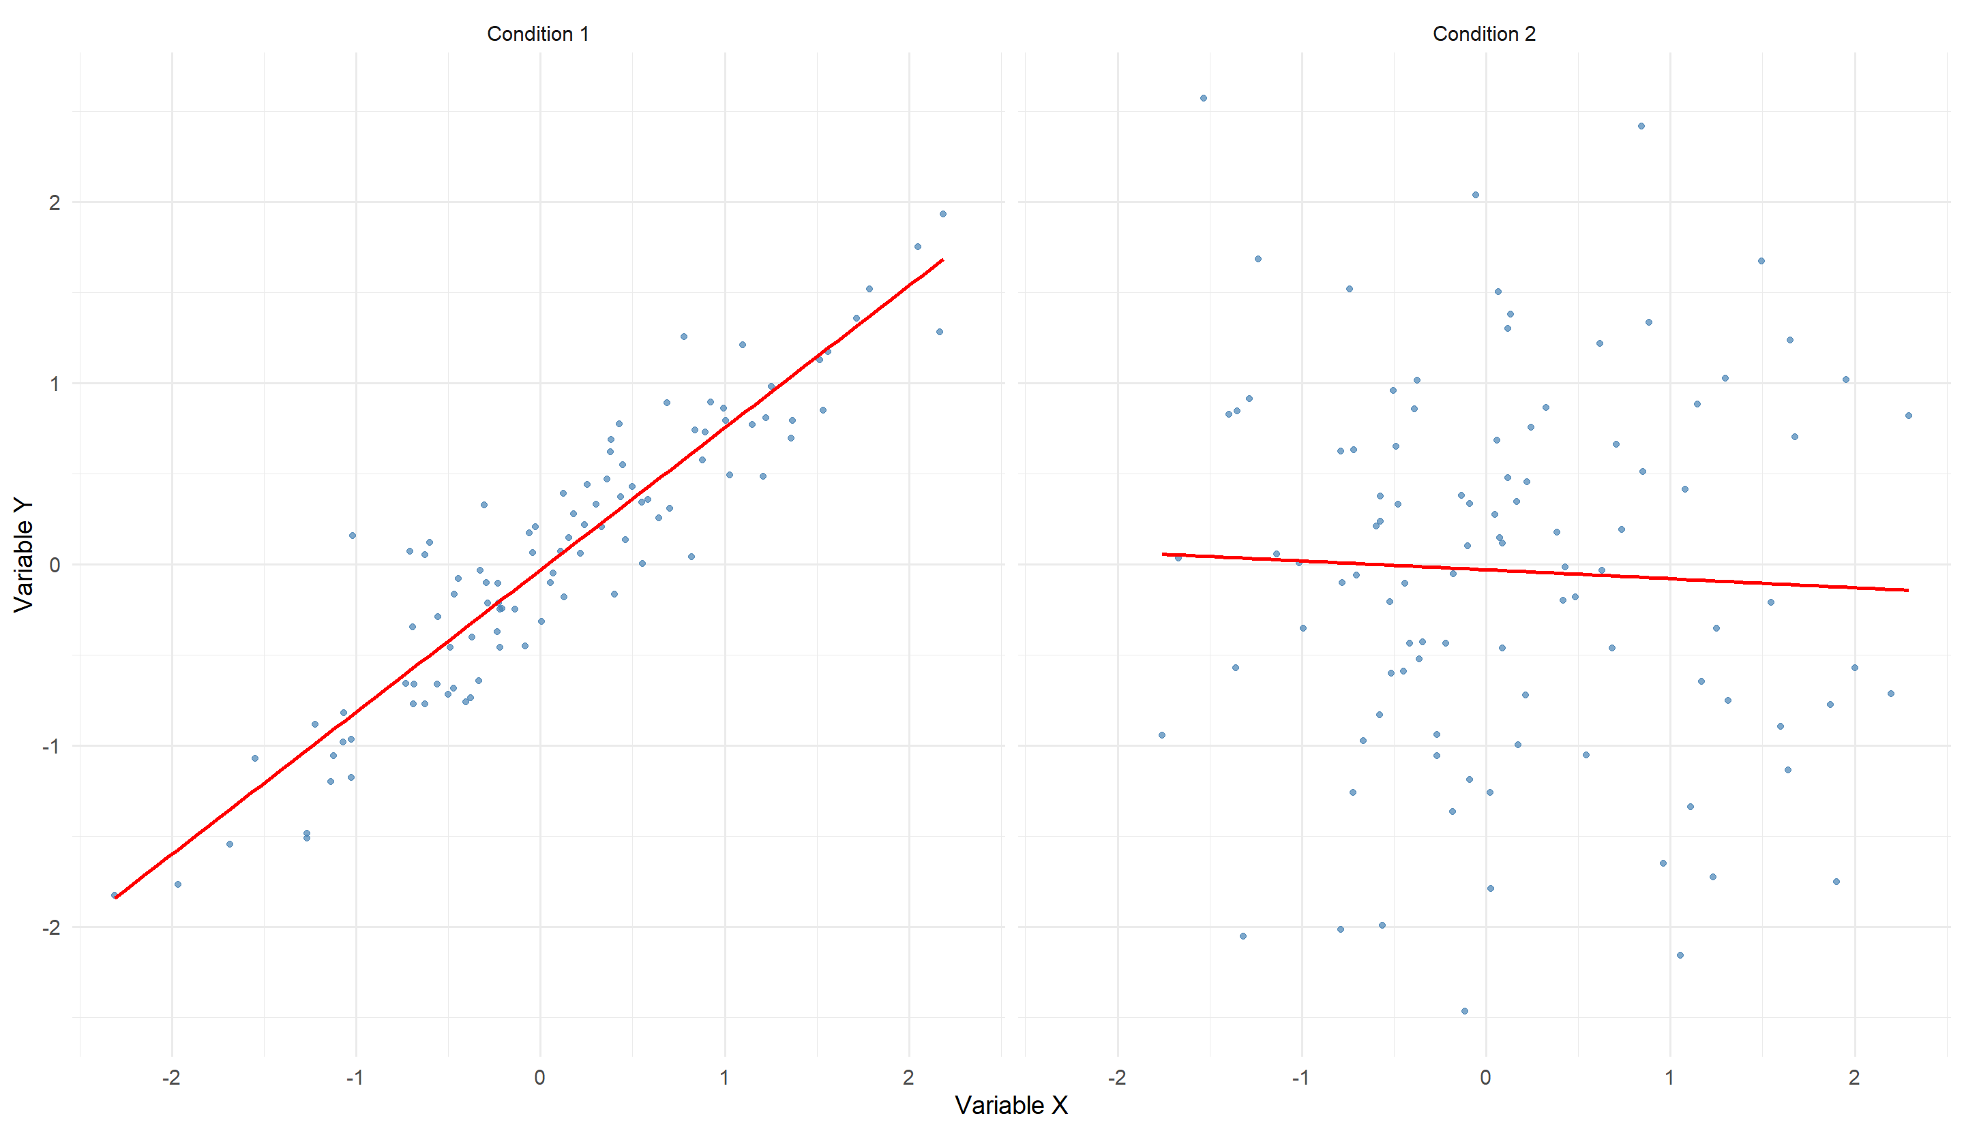

Slide 4
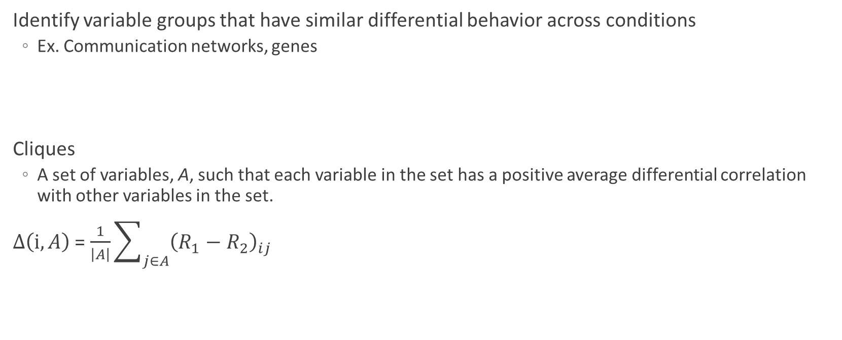
DCM
Identify variable groups that have similar differential behavior across conditions
Ex. Communication networks, genes
Cliques
A set of variables, A, such that each variable in the set has a positive average differential correlation with other variables in the set.
$Δ\left(ⅈ,A\right)$ = $\frac{1}{\left|A\right|}\sum_{j∈A}{{\left(R_{1}−R_{2}\right)}_{ij}}$

Slide 5
How DCM works
1. Determine differential correlations
2. Identify candidate sets of variables (cliques)
Start with an initial set A0 (possibly empty).
Iteratively add/remove variables based on whether they have a significant positive average differential correlation with the current set.
Stop when the set stabilizes (no variables change).
3. Assess statistical significance
Appropriate z-testing or permutation testing
Adjust for multiple testing (e.g., Benjamini-Hochberg Procedure).
4. Output significant variable sets
These sets are the ones you’d investigate further (e.g., genes that change co-expression between healthy and disease states).

Slide 6
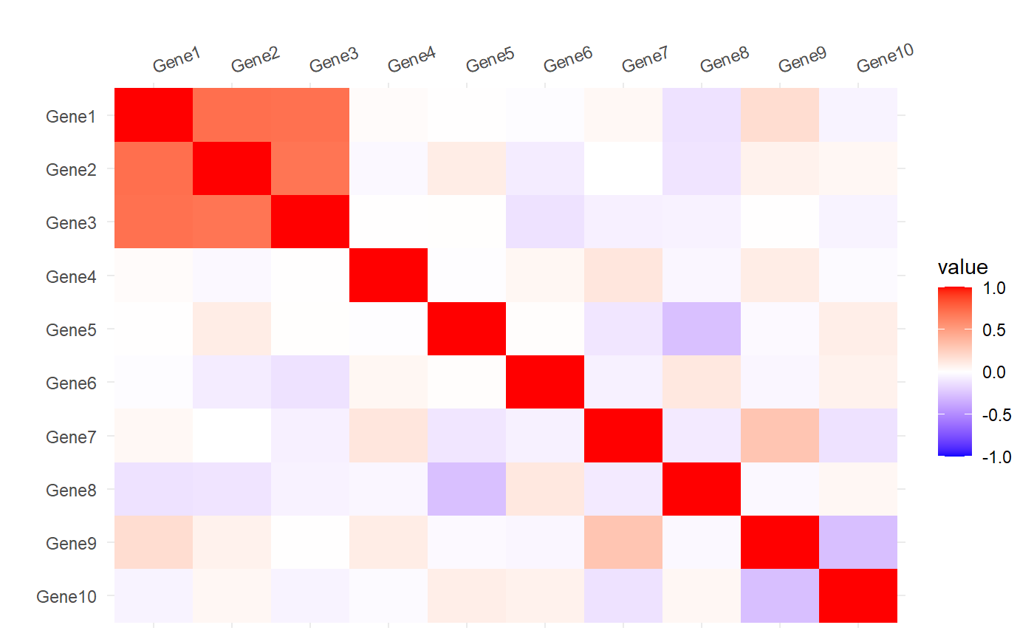
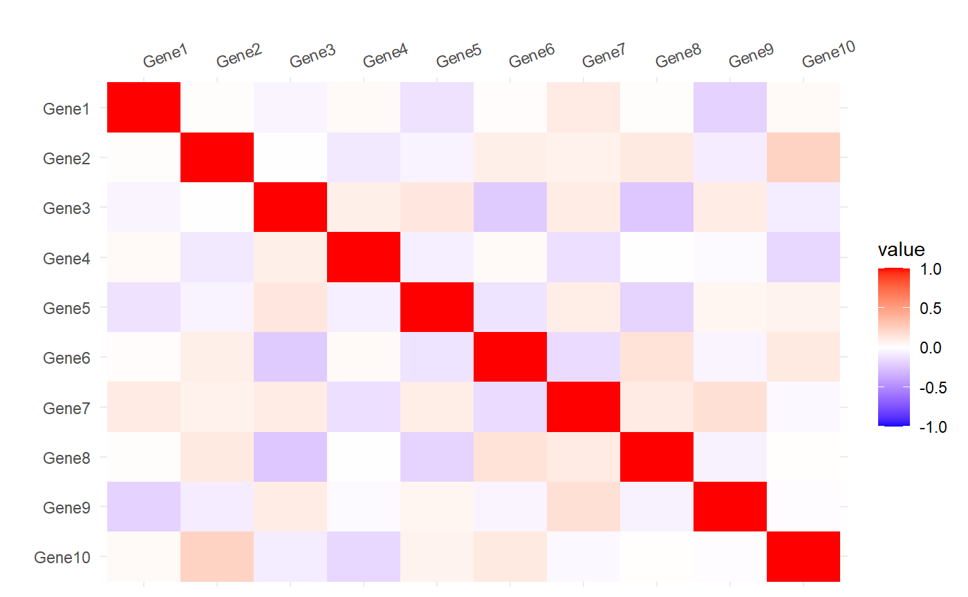
Example
Say you’re interested in gene expression for 10 different genes for 2 different types of patients:

Slide 7
Extending DCM
How could we incorporate this for more than 2 groups?
Discussed differential correlation methods only compare two groups (Condition 1 – Condition 2).
Pairwise Comparisons?
Doesn’t test for overall differences across all groups simultaneously.
Can be hard to interpret due to conflicting pairwise results.
Goal: Develop a framework that measures multi-group changes in correlation structure and apply DCM process for multiple groups.
Like ANOVA, but for correlations instead of means.

Slide 8
Thank you!

